Slide 1

OUR TEAM:
E-GARMENTS

Slide 2
introduction

Slide 3

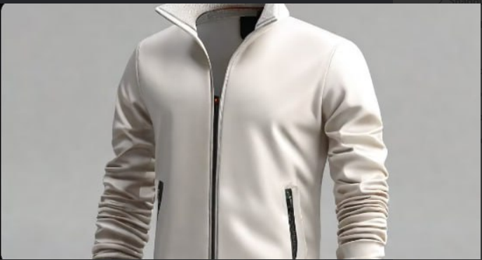

The E-GARMENTS website is an online platform that offers a wide range of garments for men, women, and children. It provides a convenient and user-friendly shopping experience for customers to browse and purchase clothing items from the comfort of their own homes.
With a focus on quality and style, the E-GARMENTS website showcases the latest fashion trends and offers a diverse selection of clothing options to suit different preferences and occasions. Whether customers are looking for casual wear, formal attire, or activewear, they can find it all on the E-GARMENTS website
introduction

Slide 4


Our mission at E-GARMENTS is to provide high-quality, fashionable clothing to customers around the world, while also promoting sustainability and ethical practices in the fashion industry.

Slide 5

Sustainability: We are committed to reducing our environmental impact and promoting sustainable fashion practices.
Quality: We strive to deliver clothing of the highest quality, ensuring customer satisfaction.
Customer Satisfaction: We prioritize customer satisfaction by providing excellent service and a seamless online shopping experience.
Our vision is to become a leading online retailer for trendy and sustainable clothing, offering a wide range of styles and sizes to cater to diverse customer preferences

Slide 6
Sustainability: We are committed to reducing our environmental impact and promoting sustainable fashion practices.
Quality: We strive to deliver clothing of the highest quality, ensuring customer satisfaction.
Customer Satisfaction: We prioritize customer satisfaction by providing excellent service and a seamless online shopping experience.
E-GARMENTS

Slide 7
E-GARMENTS

Slide 8
ABOUT E-GARMENTS:
Architecture and Technology Stack
The architecture of the E-GARMENTS website follows a client-server model, where the client-side is built using React.js and the server-side is built using Express.js and Node.js. The client-side interacts with the server-side through RESTful APIs to fetch and update data stored in the MongoDB database.
The use of the Mern stack allows for efficient development of the E-GARMENTS website, with the ability to build dynamic and responsive user interfaces and handle data storage and retrieval in a scalable and efficient manner.

Slide 9
Mern Stack Overview:
The Mern stack is a popular web development technology stack that consists of four main components:
MongoDB: A NoSQL database that stores data in a JSON-like format.
Express.js: A web application framework for Node.js that simplifies the process of building server-side applications.
React.js: A JavaScript library for building user interfaces that allows for the creation of dynamic and interactive web pages.
Node.js: A JavaScript runtime environment that allows for the execution of JavaScript code on the server-side.
By combining these four technologies, developers can create full-stack web applications that are efficient, scalable, and easy to maintain.

Slide 10
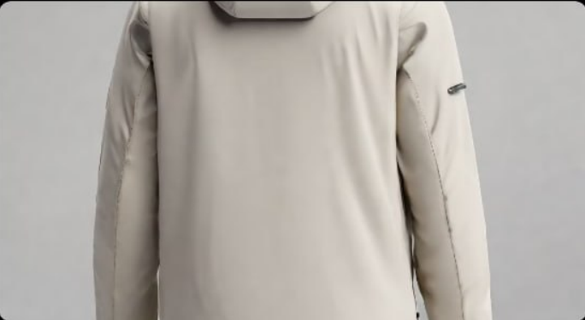
Layout:
The E-GARMENTS website features a clean and intuitive layout, making it easy for users to navigate and find the products they are looking for.

Slide 11
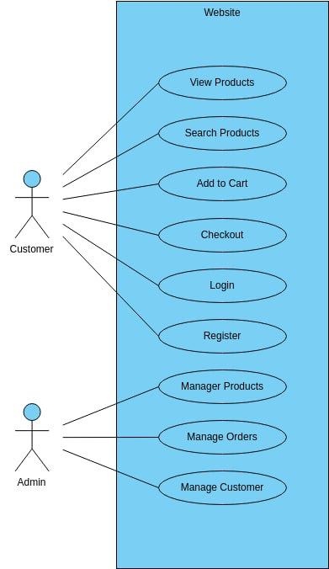
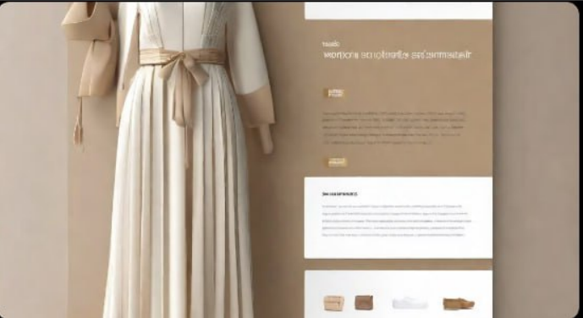
Aesthetics:
The website has a modern and stylish design, with a neutral color palette and minimalist elements that highlight the garments being showcased

Slide 12
User interface:

Slide 13
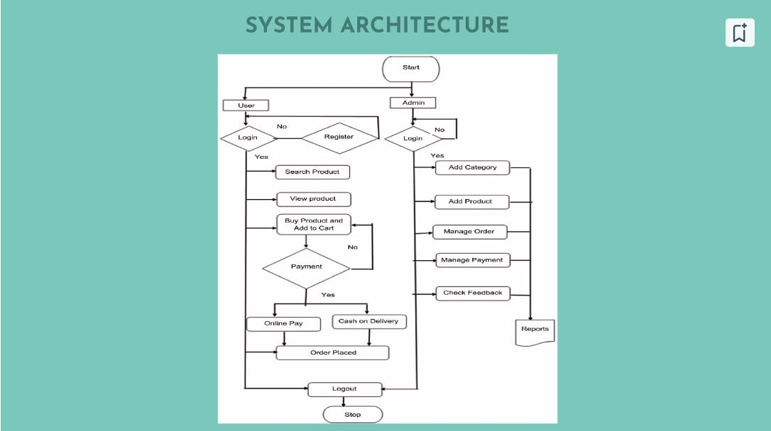
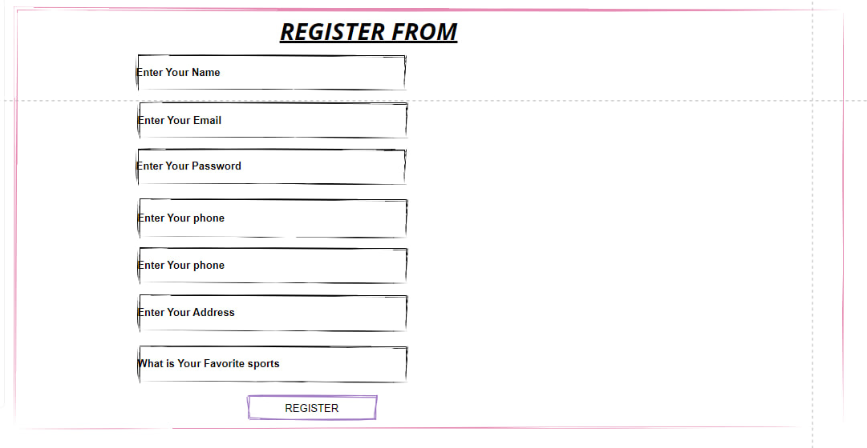
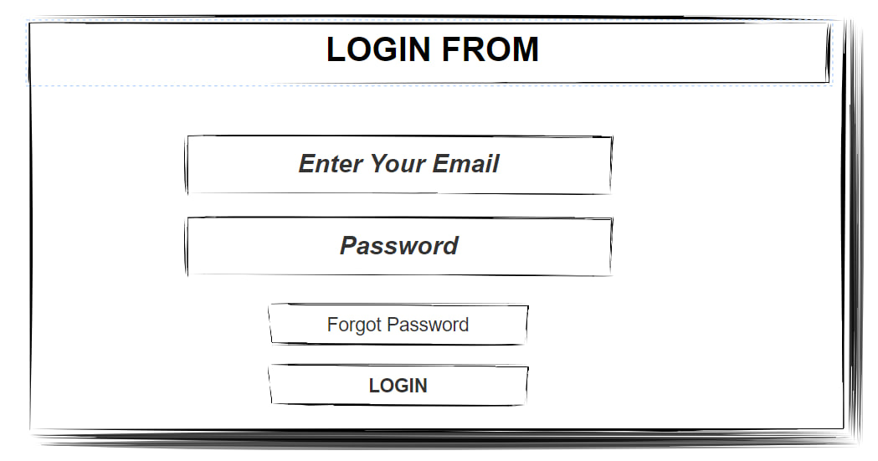
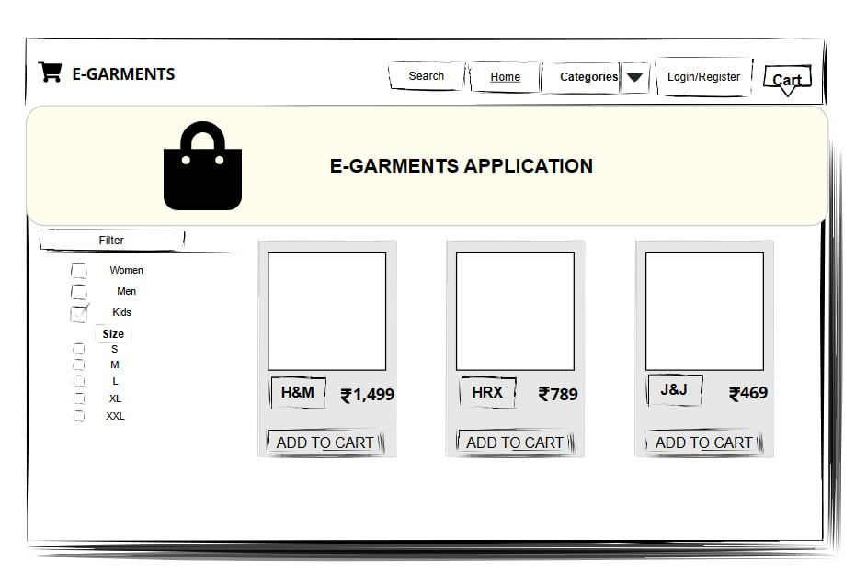
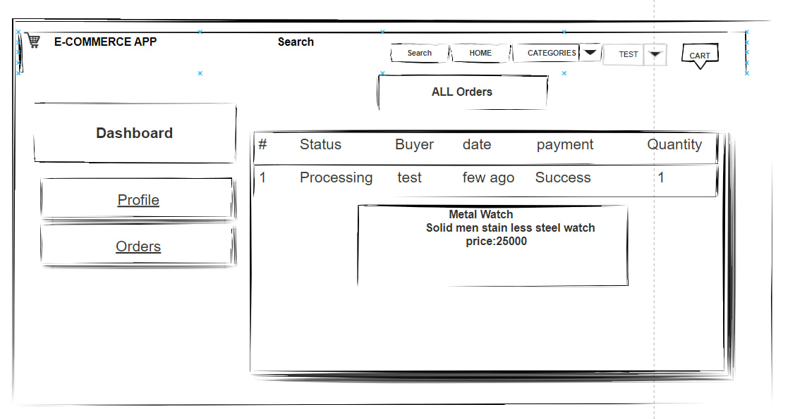
User interface:

Slide 20


